Slide 1
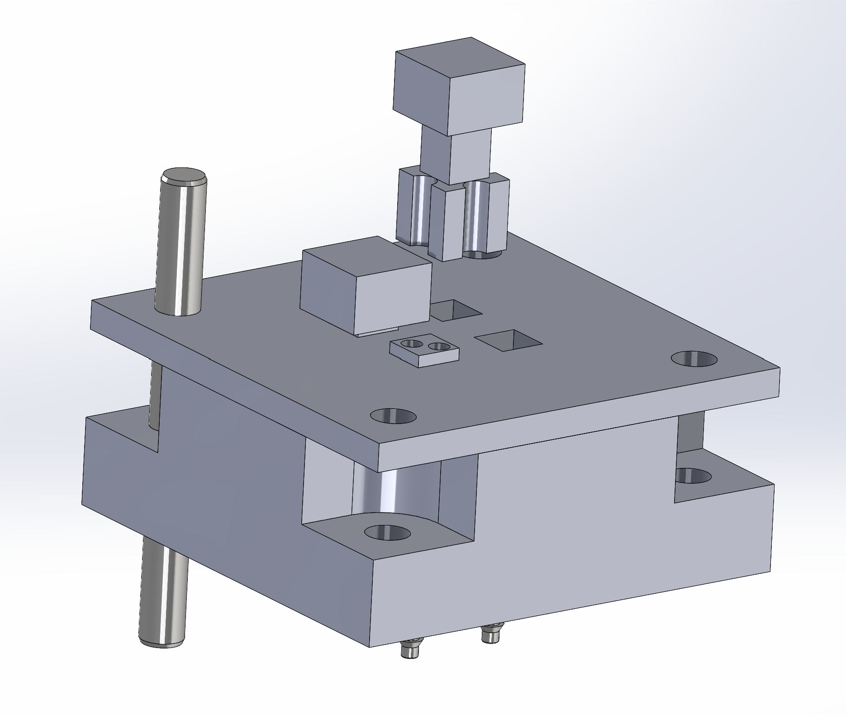
If pixel made of hardened stainless steel, 0.01 lb weight.
Press-fit steel dowel
pin for precision
location matching
Channels for air to flow through and provide lateral stabilization like an air hockey table would for the puck
Head of pixel (not shown) should have two long set screws that attach to head of pixel

Slide 2
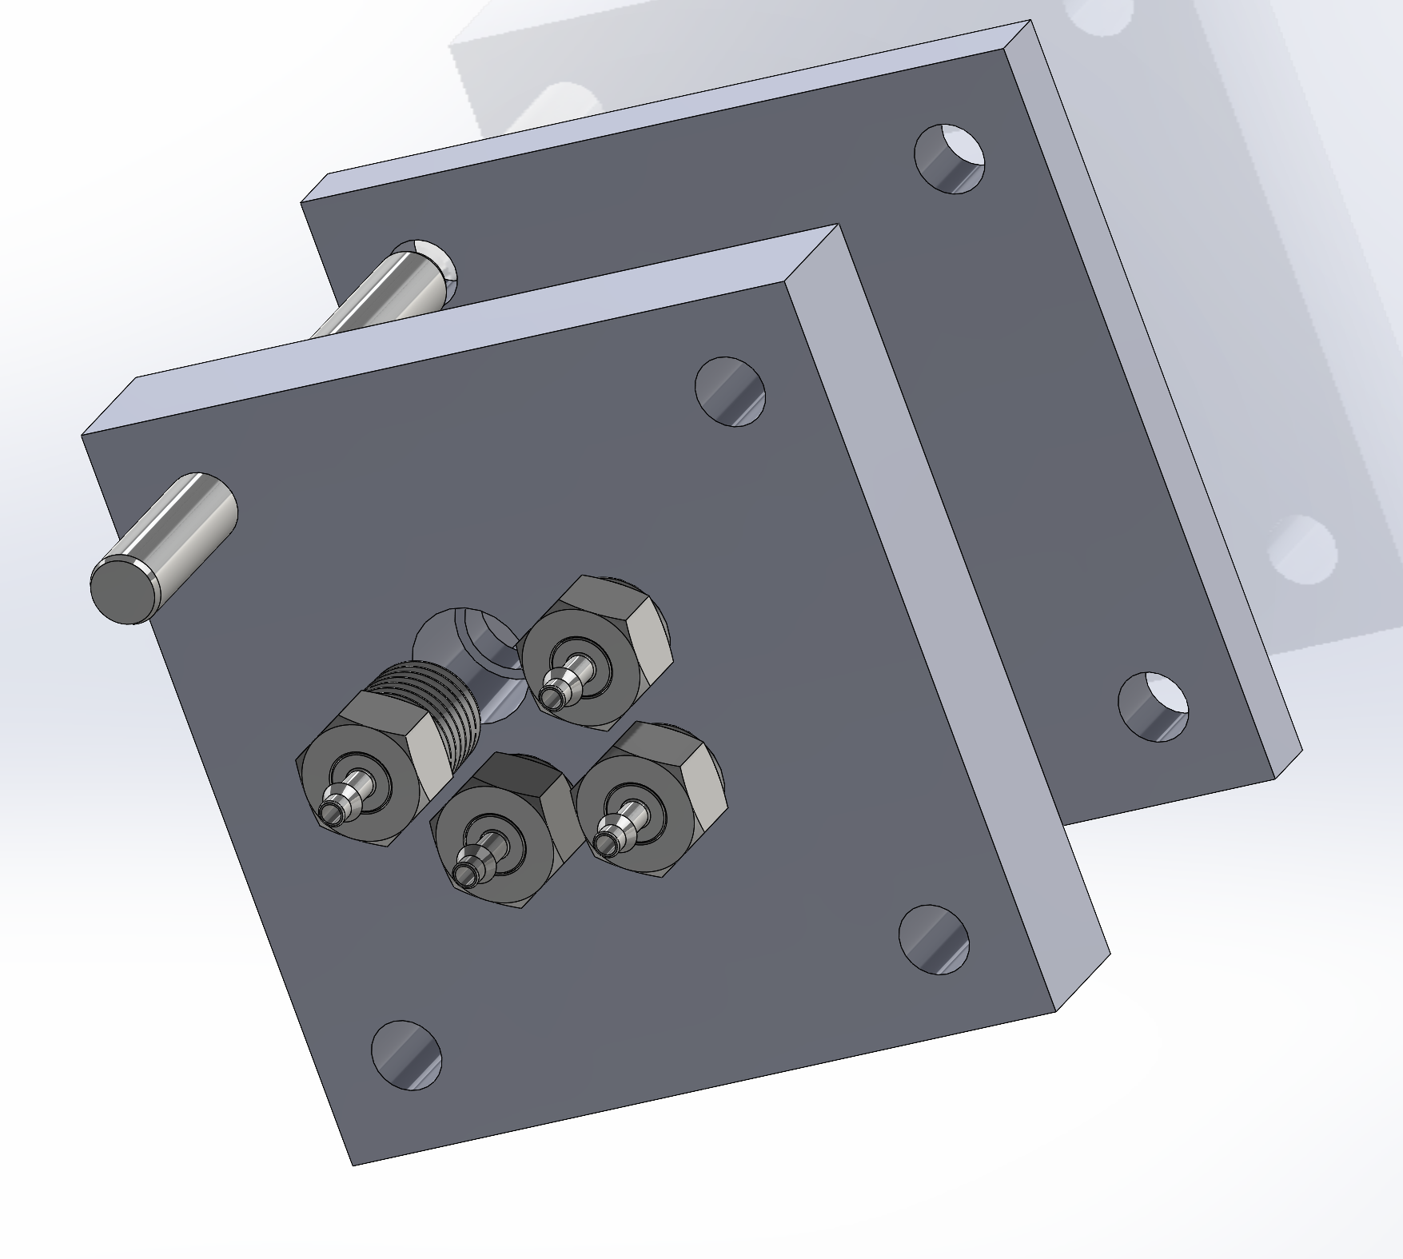
Pipe thread…never coming out. Compressed air pushes on pixel directly to lift up

Slide 3
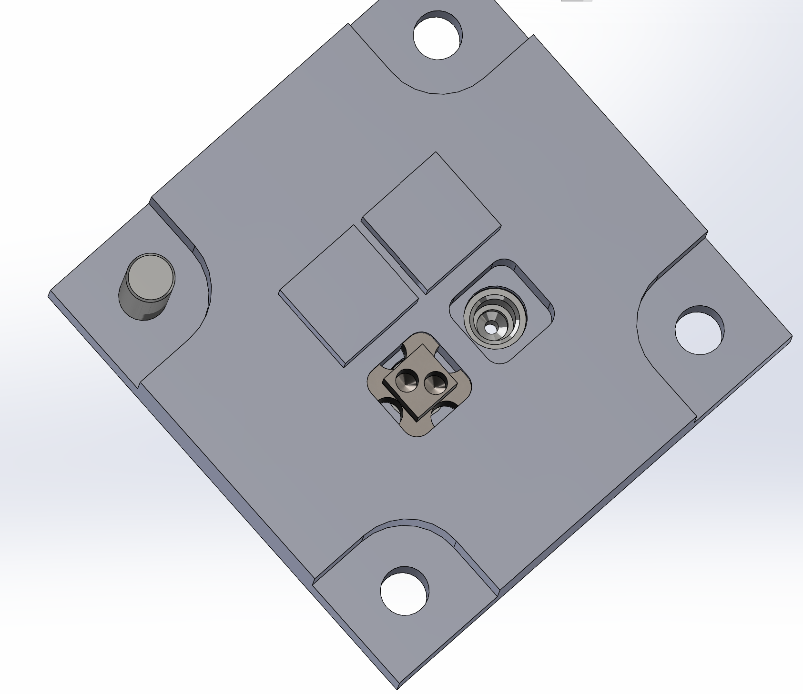
Compressed air from below pushes up and provides lateral resistance

